Slide 1
AI Recruiter

Slide 2
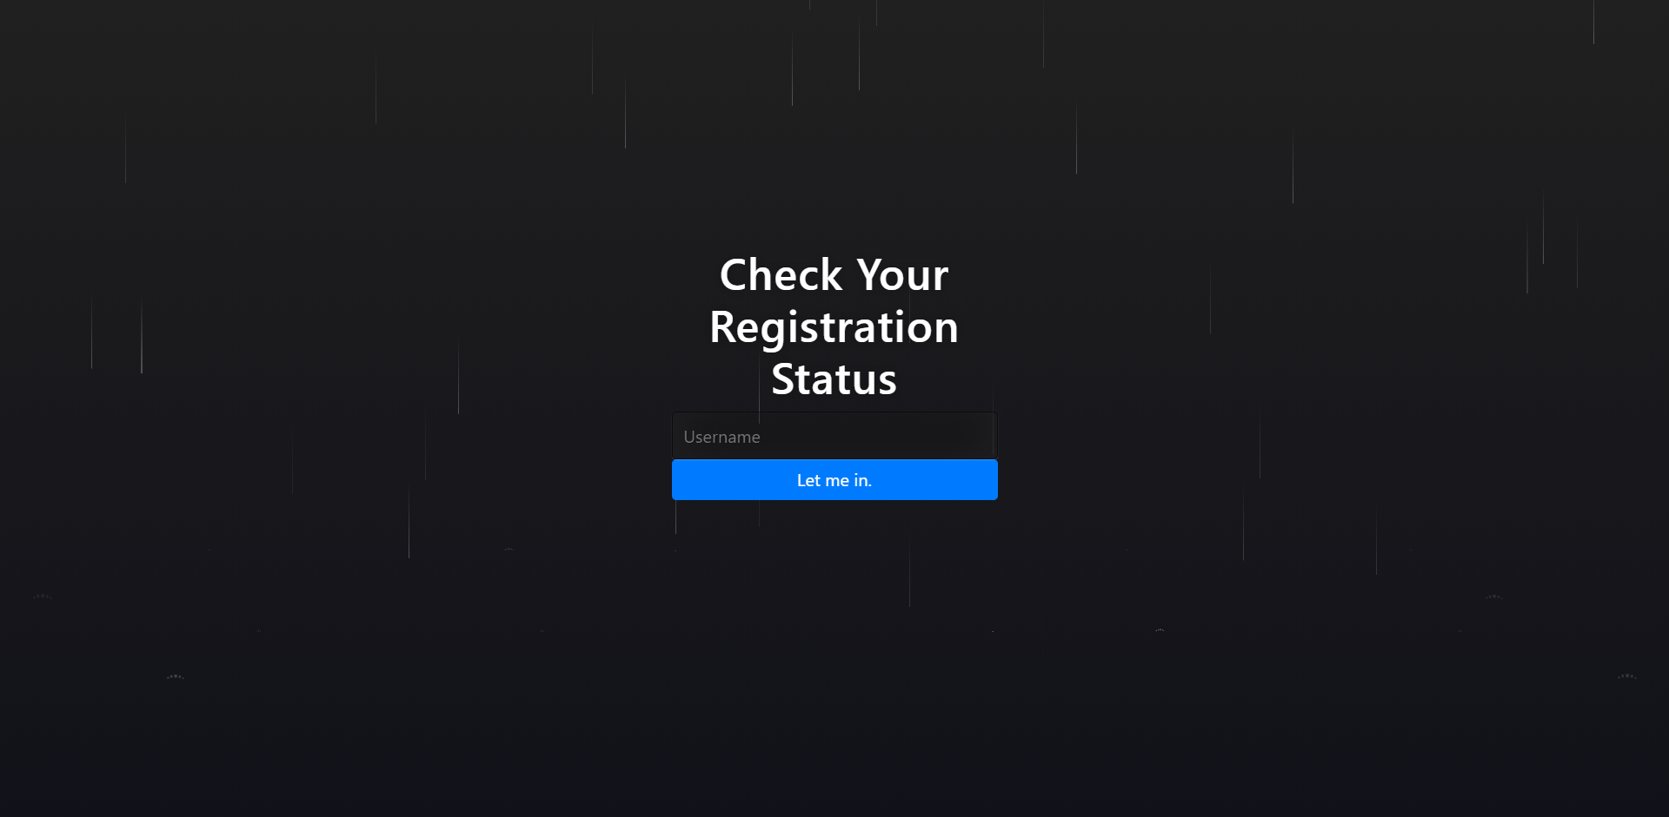
Login UI

Slide 3
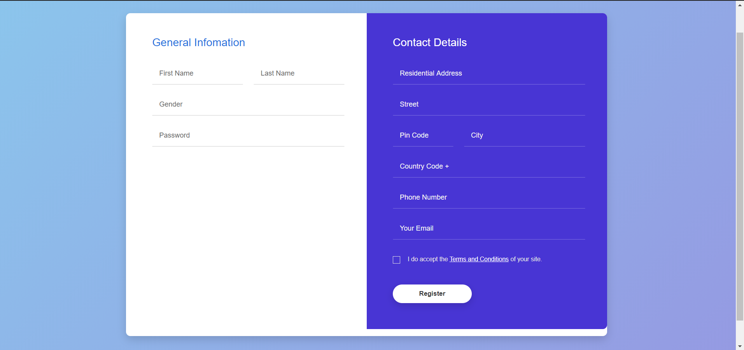
Registration form to take interview

Slide 4
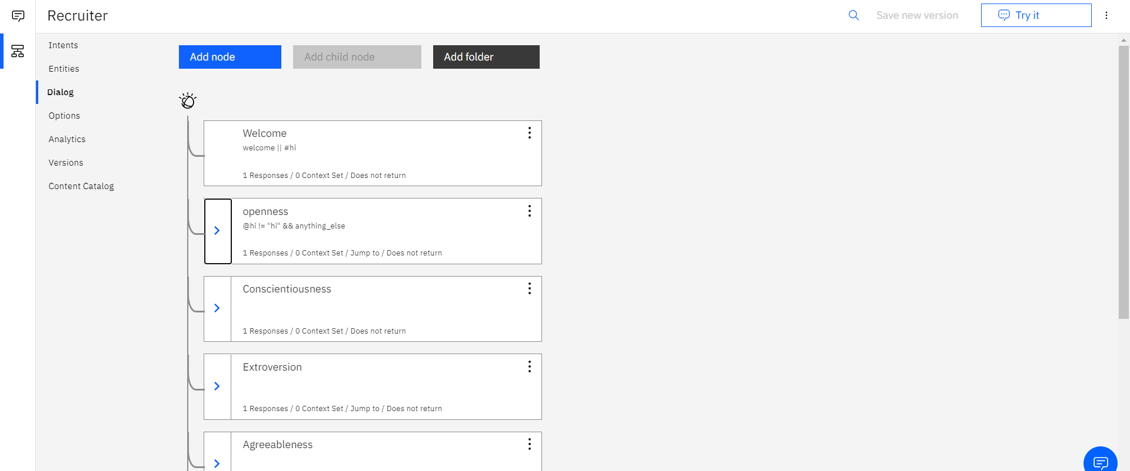
Chat bot trained with few necessary skills and addition of few more skills is in progress

Slide 5
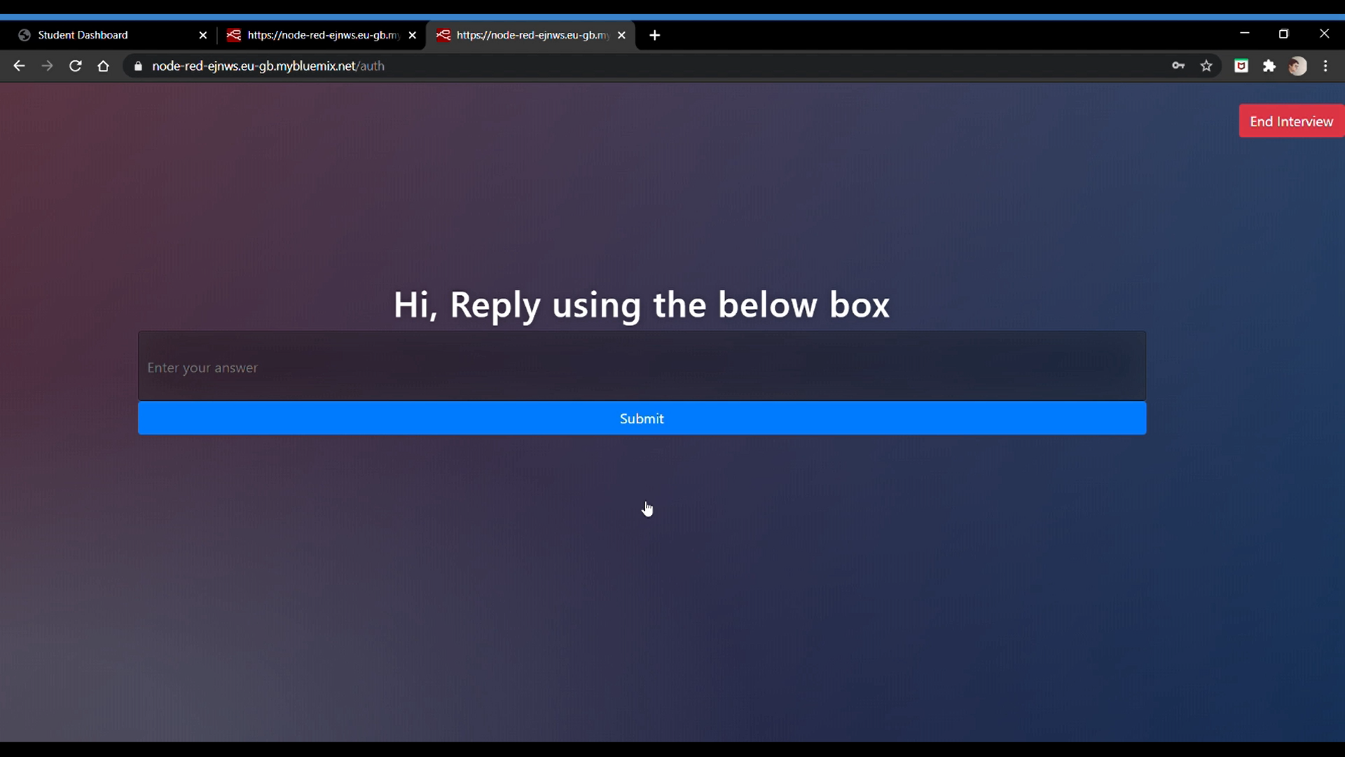
Chat bot integrated successfully

Slide 6
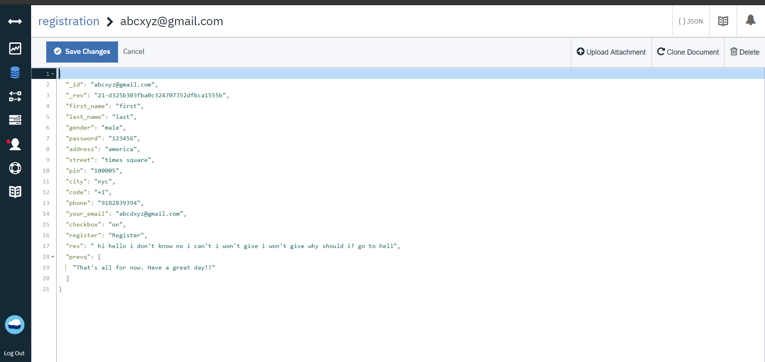
Cloudant connected

Slide 7
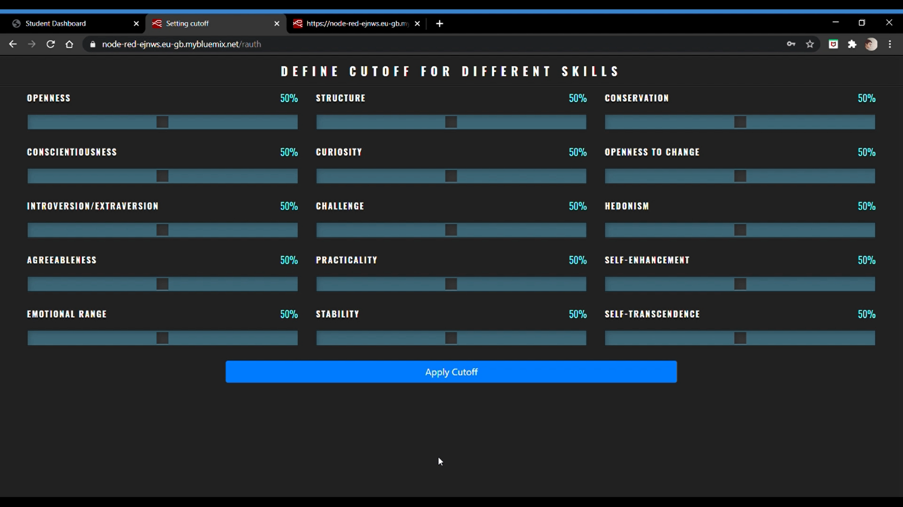
Applying Cut-off

Slide 8
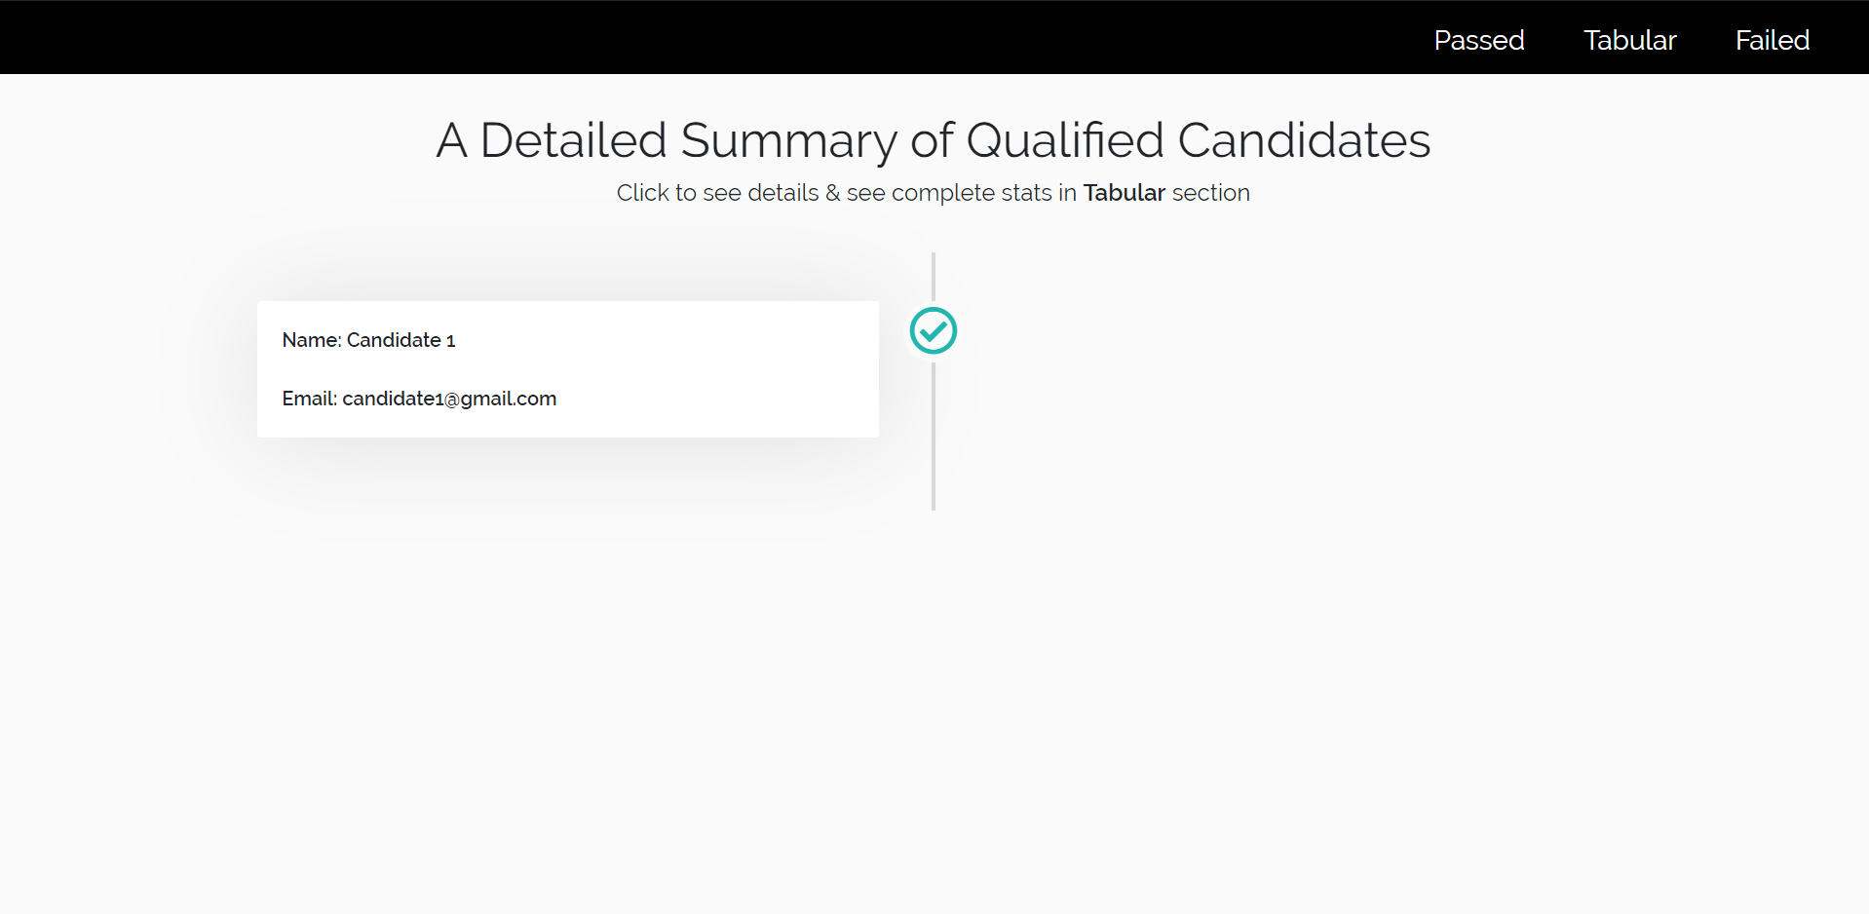
Recruiter Dashboard

Slide 9
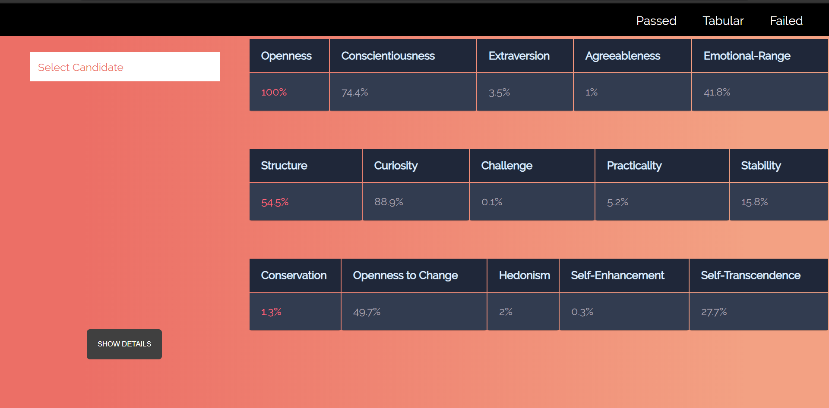
Recruiter Dashboard

Slide 10
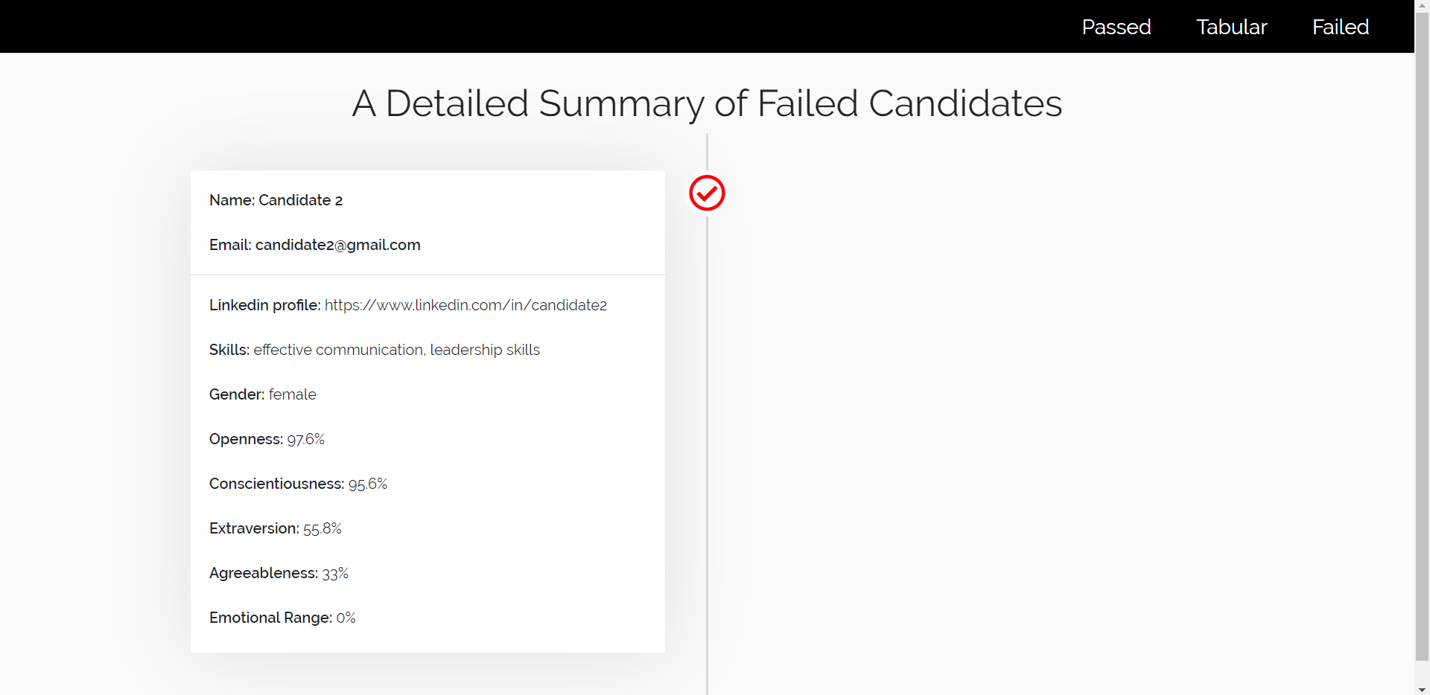
Recruiter Dashboard

